Slide 1
Sequential Circuit Design

Slide 2
Design Procedure
Specification
Formulation
Obtain a state diagram or state table
State Assignment
Assign binary codes to the states
Flip-Flop Input Equation Determination
Select flip-flop types
Derive flip-flop equations from next state entries in the table
Output Equation Determination
Derive output equations from output entries in the table
Optimization
Optimize the equations
Technology Mapping
Find circuit from equations and map to flip-flops and gate technology
Verification
Verify correctness of final design

Slide 3
Typical Sequential Circuit
Mealy Machine
C1
C2
s(t+1)
State Register
next
state
s(t)
x(t)
present
state
z(t)
present
inputs
clock

Slide 4
Typical Sequential Circuit
x
A
D
Q
Example
C
Q
A’
Next State
D
Q
B
CP
C
Q'
y
Output

Slide 5
پروژه
دانشجویانی که آزمایشگاه ندارند (سایر رشته‌ها):
انجام پروژه الزامی است.

Slide 6
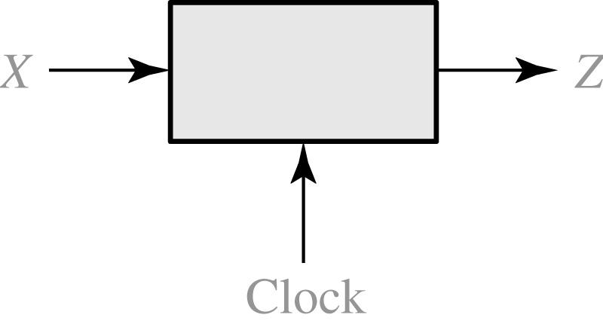
Sequence Detector
101 sequence Detector
X = | 0 | 0 | 1 | 1 | 0 | 1 | 1 | 0 | 0 | 1 | 0 | 1 | 0 | 1 | 0 | 0
Z = | 0 | 0 | 0 | 0 | 0 | 1 | 0 | 0 | 0 | 0 | 0 | 1 | 0 | 1 | 0 | 0
(time: | 0 | 1 | 2 | 3 | 4 | 5 | 6 | 7 | 8 | 9 | 10 | 11 | 12 | 13 | 14 | 15)

Slide 7
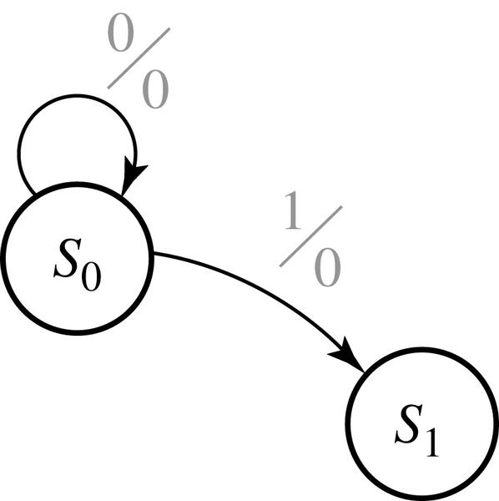
Design of 101 Sequence Detector
State Diagram:

Slide 8
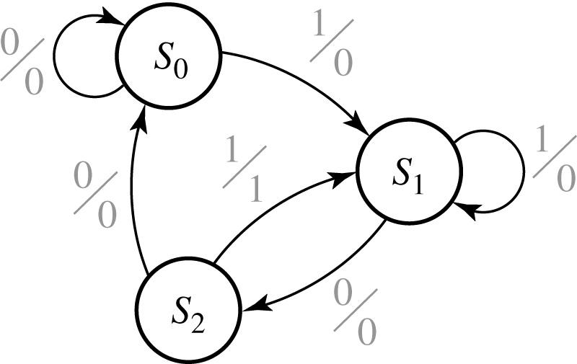
Design of 101 Sequence Detector
State Diagram (final):

Slide 9
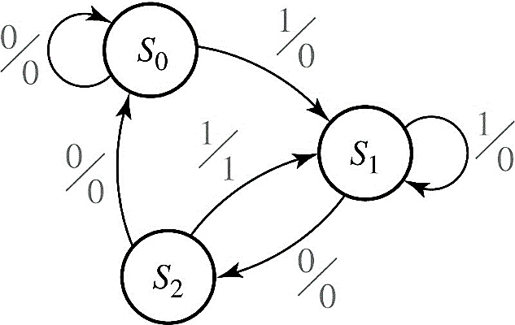
Design of 101 Sequence Detector
State Table:
Present state |  | Next State |  | Present Output
 |  | X = 0 | X = 1 | X = 0 | X =1
S₀ S₁ S₂

Slide 10

Design of 101 Sequence Detector
State Table:
Present state |  | Next State |  | Present Output
 |  | X = 0 | X = 1 | X = 0 | X =1
S₀ S₁ S₂ |  | S₀ S₂ S₀ | S₁ S₁ S₁ | 0 0 0 | 0 0 1
State Table with State Assignment:
D_{A}
D_{B}
AB |  | A⁺ B⁺ |  | Z
 |  | X = 0 | X = 1 | X = 0 | X =1
00 01 10 |  | 00 10 00 | 01 01 01 | 0 0 0 | 0 0 1

Slide 11
AB |  | A⁺ B⁺ |  | Z
 |  | X = 0 | X = 1 | X = 0 | X =1
00 01 10 |  | 00 10 00 | 01 01 01 | 0 0 0 | 0 0 1
AB
 | X | A⁺ B⁺ | Z
00 00 01 01 10 10 | 0 1 0 1 0 1 | 00 01 10 01 00 01 | 0 0 0 0 0 1

Slide 12
Design of Sequence Detector
Derive Boolean Equations:
A
B
A
A
B
A
X
00
01
11
10
X
00
01
11
10
0
0
1
X
0
0
0
0
X
0
1
0
0
X
0
1
1
1
X
1
B
B
D_{A} = X’.B
D_{B} = X
A
A
B
00
01
11
10
0
0
0
X
0
Z = X.A
1
0
0
X
1
B

Slide 13
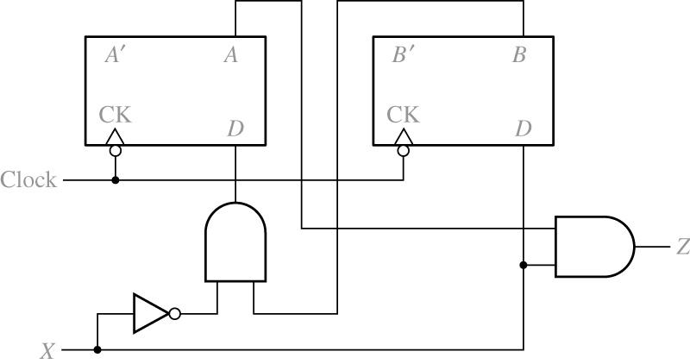
Design of Sequence Detector

Slide 14
Design of Sequence Detector
C1
C2
State Register
s(t+1)
Compare with Typical Mealy Machine
next
state
s(t)
x(t)
present
state
z(t)
present
inputs
clock

Slide 15
Design of Sequence Detector
A Moore Sequence Detector:
C2
C1
s(t+1)
z(t)
State Register
next
state
s(t)
x(t)
present
state
present
inputs
clock

Slide 16
Sequence Detector
101 sequence Detector
X = | 0 | 0 | 1 | 1 | 0 | 1 | 1 | 0 | 0 | 1 | 0 | 1 | 0 | 1 | 0 | 0
Z = | 0 | 0 | 0 | 0 | 0 | 1 | 0 | 0 | 0 | 0 | 0 | 1 | 0 | 1 | 0 | 0
(time: | 0 | 1 | 2 | 3 | 4 | 5 | 6 | 7 | 8 | 9 | 10 | 11 | 12 | 13 | 14 | 15)

Slide 17
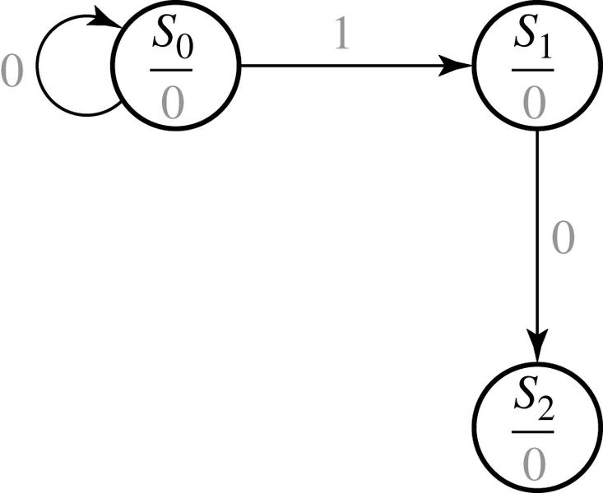
Design of a Sequence Detector
S₀: start
S₁: got 1
S₂: got 10
S₃: got 101

Slide 18
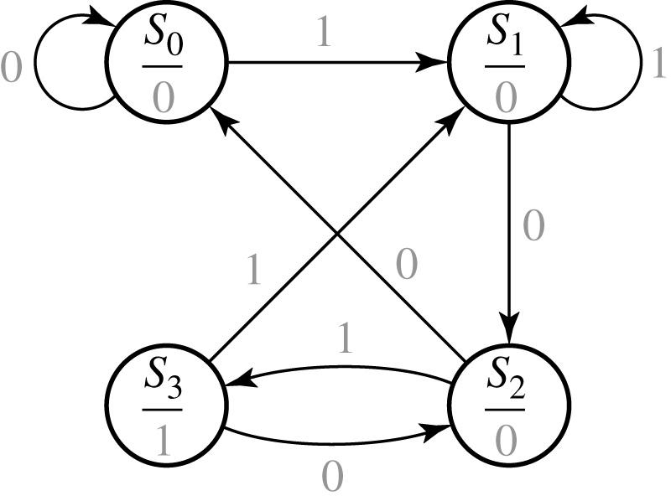
Design of a Sequence Detector
S₀: start
S₁: got 1
S₂: got 10
S₃: got 101

Slide 19
Design of a Sequence Detector
State Table
Transition Table with State assignment
Present state |  | Next State |  | Present Output (Z)
 |  | X = 0 | X = 1
S₀ S₁ S₂ S₃ |  | S₀ S₂ S₀ S₂ | S₁ S₁ S₃ S₁ | 0 0 0 1
D_{A}
D_{B}
AB |  | A⁺ B⁺ |  | Z
 |  | X = 0 | X = 1
00 01 11 10 |  | 00 11 00 11 | 01 01 10 01 | 0 0 0 1

Slide 20
State Diagram Development
To develop a sequence recognizer state diagram:
Construct some sample input and output sequences to make sure that you understand the problem statement.
Begin in an initial state in which NONE of the initial portion of the sequence has occurred (typically “reset” state).
Add a state that recognizes that the first symbol has occurred.
Add states that recognize each successive symbol occurring.
Each time you add an arrow to the state graph, determine it can go to one of the previously defined states or whether a new state must be added
The final state represents the input sequence occurrence.
Add state transition arcs which specify what happens when a symbol not in the proper sequence has occurred.
Check your state graph for completeness and non-redundant arcs.
When your state graph is complete, test it by applying the input sequences formulated in part1 and making sure the output sequences are correct

Slide 21
State Assignment
Each of the m states must be assigned a unique code.
Minimum number of bits required is n such that n ≥ log₂ m where x is the smallest integer ≥ x.
There are 2^{n} - m unused states.
(There are useful state assignments that use more than the minimum number of bits).

Slide 22
State Assignment: Example
Present
Next State
Output
State
x=0 x=1
x=0 x=1
A
A B
0 0
B
A C
0 0
C
D C
0 0
D
A B
0 1
How many assignments of codes with a minimum number of bits?
4 × 3 × 2 × 1 = 24
Does code assignment make a difference in cost?

Slide 23
State Assignment: Example
Assignment 1:
A = 00, B = 01, C = 10, D = 11
The resulting coded state table:
Present State | Next State x = 0 x = 1 |  | Output x = 0 x = 1
0 0 | 0 0 | 0 1 | 0 | 0
0 1 | 0 0 | 1 0 | 0 | 0
1 0 | 1 1 | 1 0 | 0 | 0
1 1 | 0 0 | 0 1 | 0 | 1

Slide 24
Flip-Flop Input and Output Equations: Example (version 1)
Assume D flip-flops
A
B
A
A
B
A
X
00
01
11
10
X
00
01
11
10
0
0
0
0
1
0
0
0
0
1
1
0
1
0
1
1
1
0
1
0
B
B
D_{A} = A.B’ + X.A’.B
D_{B} = X’.A.B’ + X.A’.B’+X.A.B

Slide 25
Flip-Flop Input and Output Equations: Example (version 1)
A
B
A
X
00
01
11
10
0
0
0
0
0
1
0
0
1
0
B
Z = A.B.X
Gate Input Cost = 22

Slide 26
State Assignment: Example
Assignment 2:
A = 00, B = 01, C = 11, D = 10
The resulting coded state table:
Present State | Next State x = 0 x = 1 |  | Output x = 0 x = 1
0 0 | 0 0 | 0 1 | 0 | 0
0 1 | 0 0 | 1 1 | 0 | 0
1 1 | 1 0 | 1 1 | 0 | 0
1 0 | 0 0 | 0 1 | 0 | 1

Slide 27
Flip-Flop Input and Output Equations: Example (version 2)
Assume D flip-flops
A
B
A
A
B
A
X
00
01
11
10
X
00
01
11
10
0
0
0
1
0
0
0
0
0
0
1
0
1
1
0
1
1
1
1
1
B
B
D_{A} = A.B + X.B
D_{B} = X

Slide 28
Flip-Flop Input and Output Equations: Example (version 2)
A
B
A
X
00
01
11
10
0
0
0
0
0
1
0
0
0
1
B
Z = A.B’.X
Gate Input Cost = 9
Select this state assignment

Slide 29
Implementation
Initial Circuit:
Library:
D Flip-flops with Reset (not inverted)
NAND gates with up to 4 inputs and inverters
D
Y₁
C
R
Z
Y₂
X
D
Clock
C
R
Reset

Slide 30
Technology Mapping
Y₁
D
C
R
Z
Y₂
X
D
Clock
C
R
Reset

Slide 31
Example : Vending Machine
General Machine Concept:
Deliver package of gum after 15 cents deposited
Single coin slot for dimes (10¢), nickels (5¢)
No change

Slide 32
Example : Vending Machine
Step 1: Understand the problem:
Draw a picture
5¢
Coin
Vending
Gum
Sensor
10¢
Open
Machine
Release
Reset
FSM
Mechanism
Clk

Slide 33
Example : Vending Machine
Step 2: Draw state diagram:
All possible sequences
Inputs: N, D, reset
Output: open
Reset
S0
N
D
S1
S2
Dime: 10¢
Nickel: 5¢
N
D
N
D
Notes:
If neither N nor D, goes to itself.
Both N and D is not possible.
S3
S4
S5
S6
[open]
[open]
[open]
N
D
S7
S8
[open]
[open]

Slide 34
Example : Vending Machine
Step 3: State minimization:
Reuse states whenever possible
Reset
0¢
N
Dime: 10¢
Nickel: 5¢
5¢
D
N
10¢
D
N, D
15¢
[open]

Slide 35
Example : Vending Machine
Step 4: Symbolic State table:
Present
Inputs
Next
Output
State
D
N
State
Open
Reset
0¢
0
0
0¢
0
0¢
0
1
5¢
0
1
0
10¢
0
N
1
1
X
X
5¢
5¢
0
0
5¢
0
D
0
1
10¢
0
N
1
0
15¢
0
10¢
1
1
X
X
D
10¢
0
0
10¢
0
0
1
15¢
0
N, D
1
0
15¢
0
15¢
1
1
X
X
[open]
15¢
X
X
15¢
1
From 15¢ state, you may want to go to reset state

Slide 36
Example : Vending Machine
Step 5: State encoding:
Present State
Inputs
Next State
Output
Q
1
Q
0
D
N
D
1
D
0
Open
0
0
0
0
0
0
0
0
1
0 1
0
1
0
1 0
0
1
1
X X
X
0 1
0
0
0 1
0
0
1
1 0
0
1
0
1 1
0
1
1
X X
X
1 0
0
0
1 0
0
0
1
1 1
0
1
0
1 1
0
1
1
X X
X
1 1
0
0
1 1
1
0
1
1 1
1
1
0
1 1
1
1
1
X X
X

Slide 37
Example : Vending Machine
Step 6: Choose FF for implementation:
DFF easiest
Q1 Q0
Q1
Q1 Q0
Q1
Q1 Q0
Q1
D N
D N
D N
0 0 1 1
0 1 1 0
0 0 1 0
0 1 1 1
1 0 1 1
0 0 1 0
N
N
N
X X X X
X X X X
X X X X
D
D
D
1 1 1 1
0 1 1 1
0 0 1 0
Q0
Q0
Q0
K-map for D1
K-map for D0
K-map for Open
Q
1
D
Q
D
1
D
Q
1
CLK
\
D1 = Q1 + D + Q0 N
D0 = N Q0’ + Q0 N’ + Q1 N + Q1 D
OPEN = Q1 Q0
Q
Q
Q
0
R
1
N
\reset
\
N
OPEN
Q
0
Q
0
\
N
D
D
Q
Q
Q
0
0
CLK
\
1
Q
Q
N
R
0
8 Gates
Q
\reset
1
D

Slide 38
Equivalence of Moore and Mealy Machines
Moore
Machine
N D + Reset
(N D + Reset)/0
Mealy
Machine
Reset
Reset/0
0¢
0¢
[0]
Reset
N
Reset/0
N/0
5¢
5¢
N D
D
N D/0
D/0
[0]
N
N/0
10¢
10¢
D
D/1
[0]
N D
N D/0
N+D
N+D/1
15¢
15¢
[1]
Reset
Reset/1
Outputs are associated
with State
Outputs are associated
with Transitions

Slide 39
پروژه:
به محض اعلام، روی آن کار کنيد.
در آزمايشگاه از مدرس راهنمايي بگيريد

Slide 40
Using Other FFs for Design
Characteristic Table:
defines the next state of the flip-flop in terms of flip-flop inputs and current state.
Used in Circuit Analysis
Excitation Table:
defines the flip-flop input variable values as function of the current state and next state.
Used in Circuit Design

Slide 41
SR FF Tables
Characteristic Table:
S
R
Q(t
+
1)
Operation
0
0
Q(t)
No change
0
1
0
Reset
1
0
1
Set
1
1
?
Undefined
Excitation Table:
Q(t)
Q(t+
1)
S
R

Slide 42
SR FF Tables
Characteristic Table:
S
R
Q(t
+
1)
Operation
0
0
Q(t)
No change
0
1
0
Reset
1
0
1
Set
1
1
?
Undefined
Excitation Table:
Q(t)
Q(t+
1)
S
R
Operation
0
0
0
X
No change / Reset
0
1
1
0
Set
1
0
0
1
Reset
1
1
X
0
No change / Set

Slide 43
DFF Tables
Characteristic Table:
D
Q(t
+
1)
Operation
0
0
Reset
1
1
Set
Excitation Table:
Q(t)
Q(t+
1)
D

Slide 44
DFF Tables
Characteristic Table:
D
Q(t
+
1)
Operation
0
0
Reset
1
1
Set
Excitation Table:
Q(t)
Q(t+
1)
D
0
0
0
0
1
1
1
0
0
1
1
1

Slide 45
JK FF Tables
Characteristic Table:
J
K
Q(t+1)
Operation
0
0
Q(t)
No change
0
1
0
Reset
1
0
1
Set
1
1
Q(t)
Complement
Excitation Table:
Q(t)
Q(t+1)
J
K
Operation
0
0
0
1
1
0
1
1

Slide 46
JK FF Tables
Characteristic Table:
J
K
Q(t+1)
Operation
0
0
Q(t)
No change
0
1
0
Reset
1
0
1
Set
1
1
Q(t)
Complement
Excitation Table:
Q(t)
Q(t+1)
J
K
Operation
0
0
0
X
No change / Reset
0
1
1
X
Set / Toggle
1
0
X
1
Reset / Toggle
1
1
X
0
No Change / Set

Slide 47
T FF Tables
Characteristic Table:
T
Q(t+1)
Operation
0
Q(t)
No change
1
Q(t)
Complement
Excitation Table:
Q(t)
Q(t+1)
T
Operation
0
0
0
No change
0
1
1
Toggle
1
0
1
Toggle
1
1
0
No Change

Slide 48
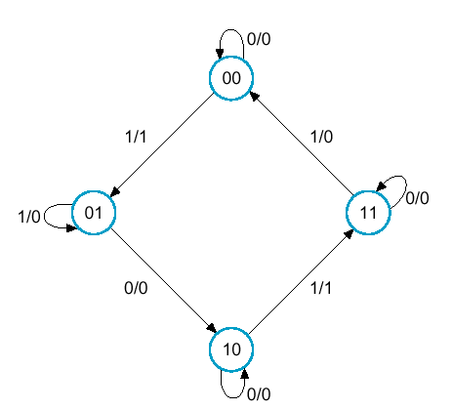
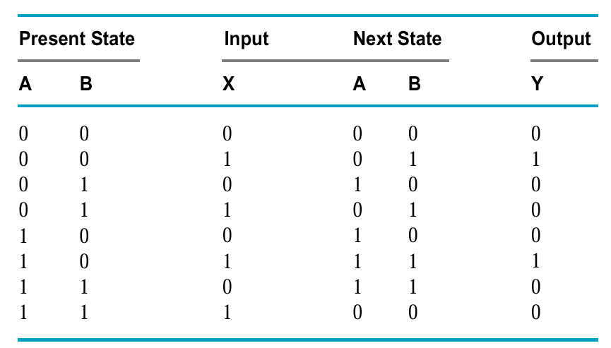
Example
Design by DFF

Slide 49
Example
A(t + 1) = DA(A,B,X) = Σ m(2,4,5,6)
B(t + 1) = DB(A,B,X) = Σ m(1,3,5,6)
Y(A,B,X) = Σ m(1,5)
BX
A
BX
A
DA = AB + BX
DB = AX + BX + ABX
BX
A
Y = BX

Slide 50
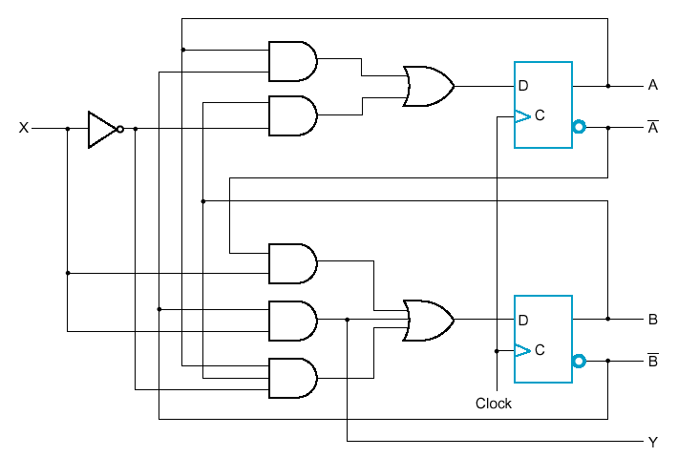
Example
Logic Diagram for Circuit with D Flip-Flops

Slide 51
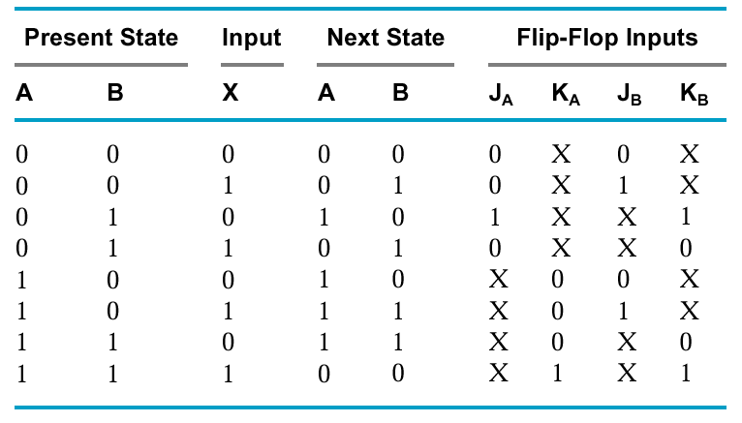
Example
Q(t)
Q(t+1)
J
K
Operation
0
0
0
X
No change/reset
0
1
1
X
Set/Toggle
1
0
X
1
Reset/Toggle
1
1
X
0
No Change/set

Slide 52
Example
Q(t)
Q(t+1)
J
K
Operation
0
0
0
X
No change/reset
0
1
1
X
Set/Toggle
1
0
X
1
Reset/Toggle
1
1
X
0
No Change/set
Don’t cares
lead to simpler combinational circuit

Slide 53
Example: Boolean Equations
JA = BX JB = X
KA = BX KB = AX + AX

Slide 54
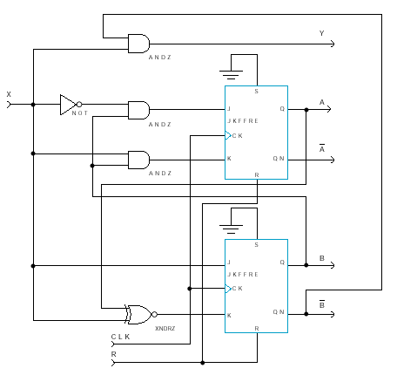
Example: Logic Diagram

